Slide 1
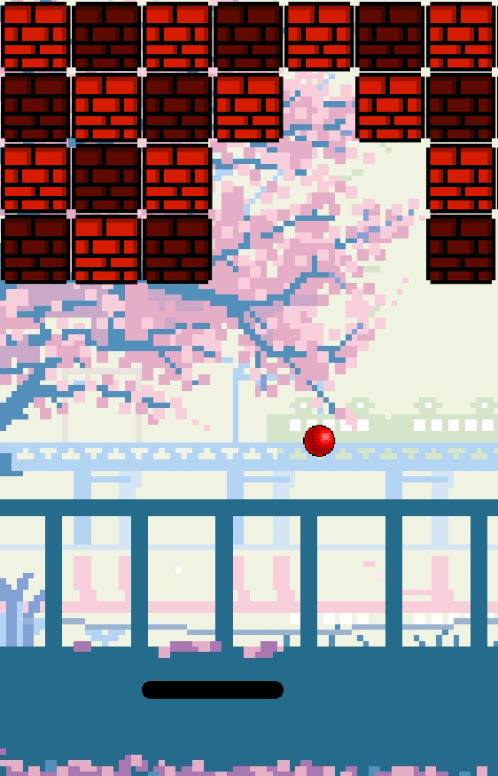
Wall Breaker!: An Arkanoid-Style Game in C Using Raylib
Welcome to Wall Breaker!, a captivating Arkanoid-style game developed using the powerful Raylib library in C. This presentation will explore the game's design, implementation, and future prospects.

Slide 2
Introduction:
The Game
Objective
Wall Breaker! is a classic brick-breaking game, inspired by the legendary Arkanoid. Players control a paddle to bounce a ball and break a wall of bricks. The objective is to clear all bricks before the ball falls below the paddle and the player loses all the lives.
The game's primary objective is to provide an engaging and challenging experience for players of all skill levels. Its simple mechanics and addictive gameplay are designed to capture the essence of classic arcade games while incorporating modern elements.

Slide 3
Methodology: Building the Game
1
Initialization
2
Game Flow & Logic
3
Rendering
Game components like the paddle, ball, bricks, sounds, and textures are loaded. The game utilizes keyboard input for paddle movement. The left and right arrow keys control the paddle's horizontal position, enabling players to strategically position the paddle to intercept the ball.
The core game logic handles ball physics, collision detection, and brick destruction. When the ball collides with the paddle, it bounces off at a calculated angle, while collisions with bricks result in their destruction. When all bricks are broken, the game is won, If the player loses all their lives, the game ends.
Raylib is used for rendering the game's visuals, including the game world, the paddle, the ball, and the bricks. The library's powerful graphics capabilities allow for a smooth and visually appealing gameplay experience. Audio elements are triggered based on game events.

Slide 4




Architecture: Visualizing Game Flow
Initialization
Rendering
Input Handling
Game Flow & Logic
Upon Launching the game, the Window Console appears. It is on this console that users play the game. The game graphics and mechanics are rendered in here.
The rendering process uses Raylib to display the game world, including the paddle, ball and bricks. The visual elements are updated based on the game logic's calculations, providing a dynamic and responsive gameplay experience. Collisions with bricks generate distinct sounds, and background music creates an atmosphere.
The game receives input from the player, from the keyboard for paddle control. The input is processed to determine the paddle's movement and direction.
The game logic handles the ball's movement, collisions with the paddle, bricks, and walls, as well as brick destruction. These calculations occur constantly within the game loop.

Slide 5
Advantages and Disadvantages
Advantages
Disadvantages
Simple and Engaging Gameplay
Limited Gameplay Variety
Smooth Graphics and Sound Effects
Potential for Repetition
Low resource requirements
No advanced AI or difficulty scaling
Cross-Platform Support
Customizable (new levels, power-ups, etc.)

Slide 6
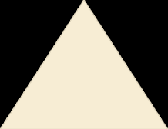



Future Scope
Level Design
1
Implementing levels with varying brick layouts, speed variations, and unique power-ups could create a more diverse and challenging experience.
Game Modes
2
Introducing additional game modes, such as a time trial mode, a survival mode, or a multi-player mode, could enhance player engagement and provide more options for different playstyles.
Enhanced Graphics
3
Utilizing more advanced graphics techniques and better textures could create a visually stunning and immersive experience.
4
Mobile version
Port the game to mobile devices using Raylib’s support for mobile platforms.

Slide 7
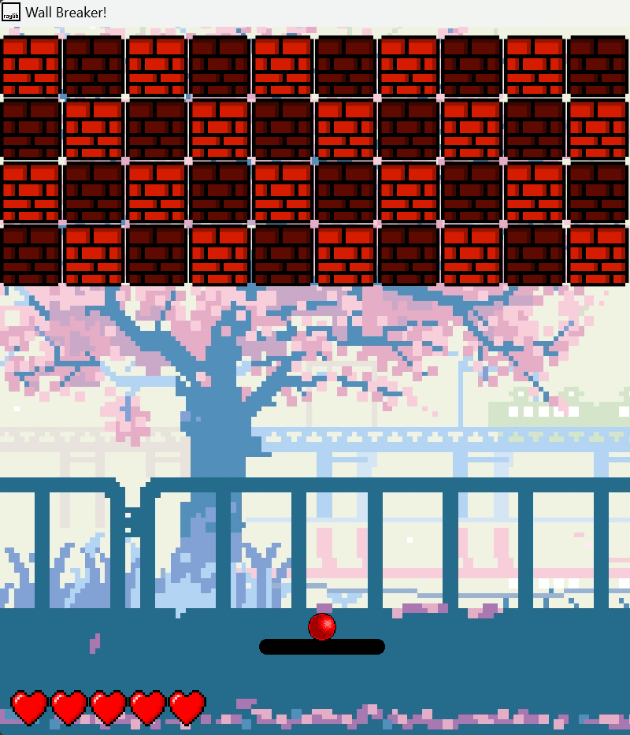
Conclusion
Summary: Wall Breaker! is a fun, simple Arkanoid-style game that challenges players to break all the bricks using a ball while avoiding the ball from falling off the screen. Developed in C with Raylib, the game offers an engaging experience with smooth graphics and sounds.

Slide 8

References
Raylib Documentation: https://www.raylib.com/
Arkanoid Wikipedia Page: https://en.wikipedia.org/wiki/Arkanoid
Asset Credits:
Background image, ball texture, and brick textures. (Google.com)
Music and sound effects.

Slide 9

Thank You!
Thank you, Parvathy Ma'am, for your guidance, support, and encouragement throughout this project. This project was a valuable learning experience, and we are grateful for the opportunity to work on it. Together, we worked hard to make this project a success!
Team Members:
Anabha N N - AM.SC.U4CSE23104
Akhil Kannan - AM.SC.U4CSE23105
Abhay Mathummal - AM.SC.U4CSE23102
Josewin Anto - AM.SC.U4CSE23125

